Slide 1

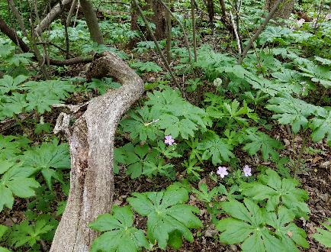
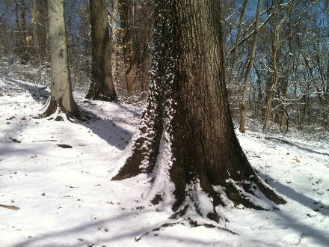
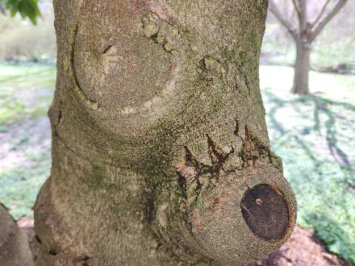
Planting and Caring for Trees for Long-Term Health and Safety
Orsolya Lazar
DCNR Bureau of Forestry
2024
Notes:
Natural areas where trees grow vs altered, managed sites: organic mulch, exposed root flare, limb loss as natural process

Slide 2

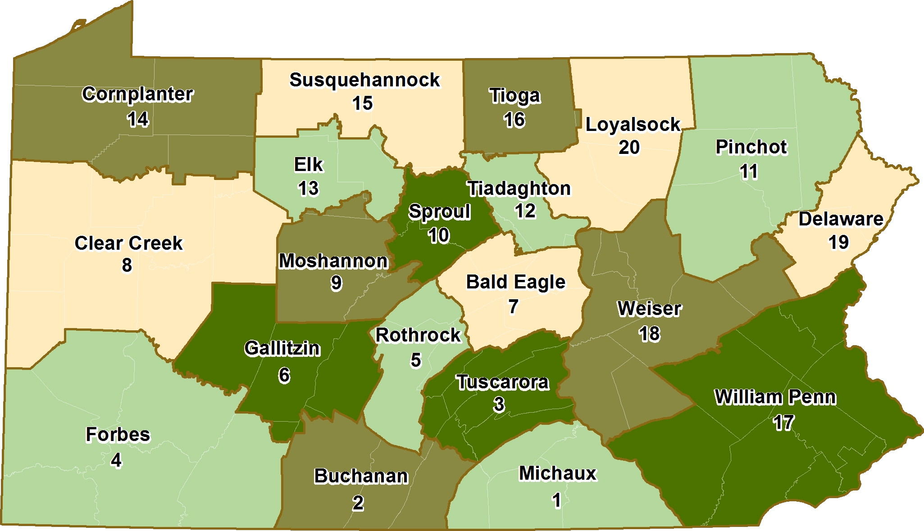
Pennsylvania’s Forests
17 million forested acres in PA
Northern hardwood forest
Oak-hickory forest
Great Lakes beech-maple forest
Mesophytic forest
$20 billion wood products industry that directly employs 60,000 people
State Forest System has 2.2 million acres
70% is privately owned –remaining is federal/local
86,000 miles of waterways-second in the US

Slide 3
Service Foresters
Landowner visits
Sustainable forest management technical assistance
Cost-share assistance
Information on hiring a forestry consultant
Regional planning advice
Advice on forestry and water-related best management practices
Forest, insect and disease identification and management
Invasive species identification and management
Presentation of educational forestry-related programs to a variety of audiences
Urban and Community forestry management assistance
Review township ordinances
Tree City USA
Lawn to meadow/forest conversion technical assistance
Open space technical assistance
Tree planting and maintenance
Riparian Buffers
Grant reviews and technical assistance
Riparian forest buffers

Slide 4
Topics
Benefits of trees
Buying, planting and mulching
Pruning and other mechanical damages
Harmful conditions, how to do better
DCNR resources

Slide 5
Benefits of Trees
As trees grow, their monetary value and their ecological benefits increase.
But…
Life expectancy of suburban trees is low.
Up to 93% of trees are planted and cared for incorrectly.
Proper care =
increased lifespan and benefits + reduced risks
Notes:
93% of trees are planted too deep or mulched high, or both according to a study from 80s/90s? It has not gotten better

Slide 6
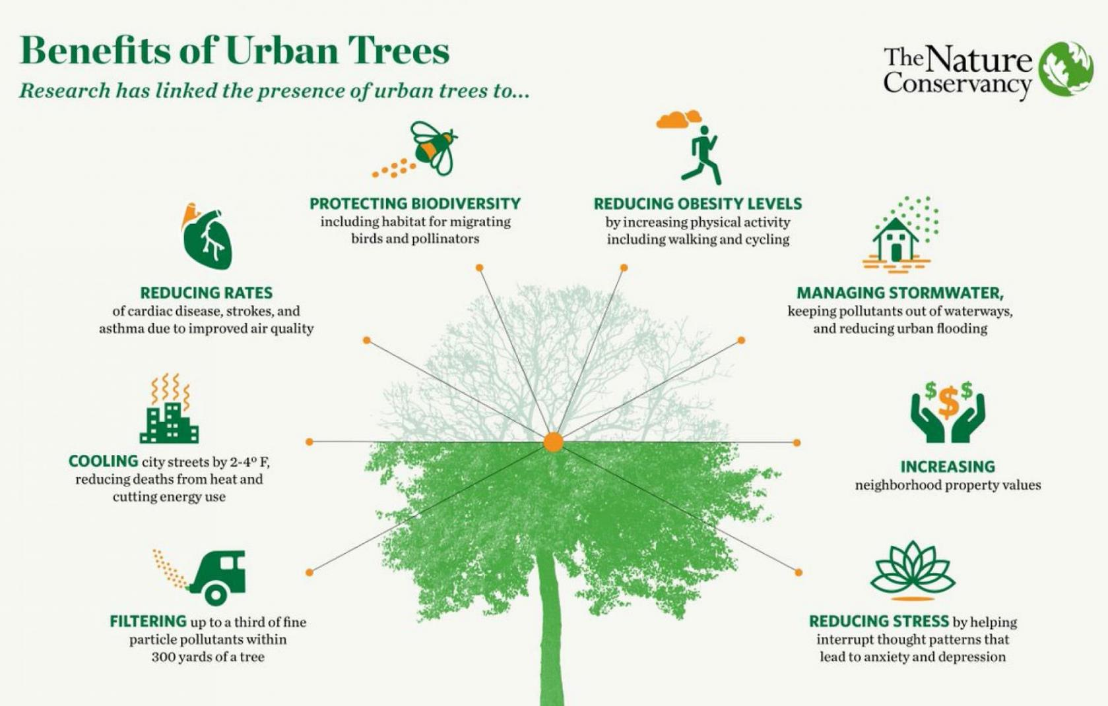
Benefit of trees
Drawbacks
Need maintenance
Cost of care
Block sun or view
Potential danger

Slide 7


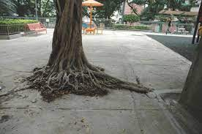
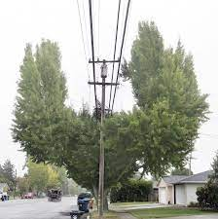
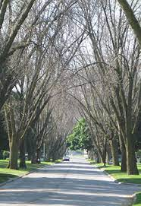
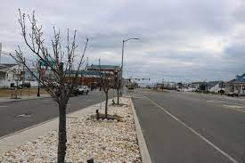
Planning For The Future
Basic Street Tree Rules
Right Tree, Right Place
Adapted to soil and microclimate changes
Durable and long lasting
Size at maturity: Height, width
Rooting tendencies
Diversity
Ash and EAB
Long term outlook
What will that street look like in 20, 30, 50 Years?
Further development
New invasive diseases and insects
What will weather and temperatures be like?

Slide 8
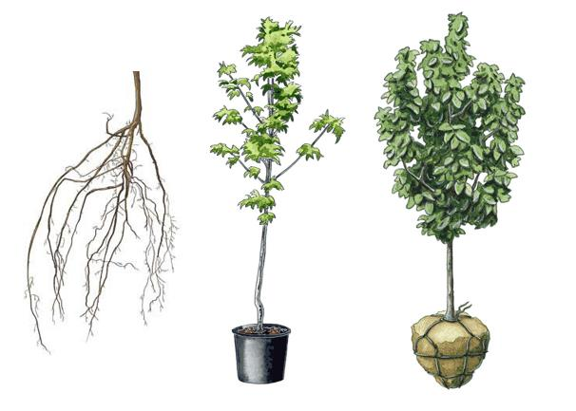
Nursery Stock
Bare root | Containerized | B & B
ADVANTAGES: Inexpensive Healthy roots Lightweight | Year-round availability | Larger specimens (May or may not have circling roots)
DRAWBACKS: Limited planting time Limited selection | More expensive Circling roots Pot bound | More expensive Root loss Heavy
Plant within days Don’t let roots dry out | Remove potting mix Fix circling roots Find root flare | Cut basket off Find root flare Remove burlap and ties
Notes:
Selecting the proper species suitable for the existing site conditions is essential. The closer the site conditions match the ideal for the specific species, the healthier, more resistant it will be.

Slide 9
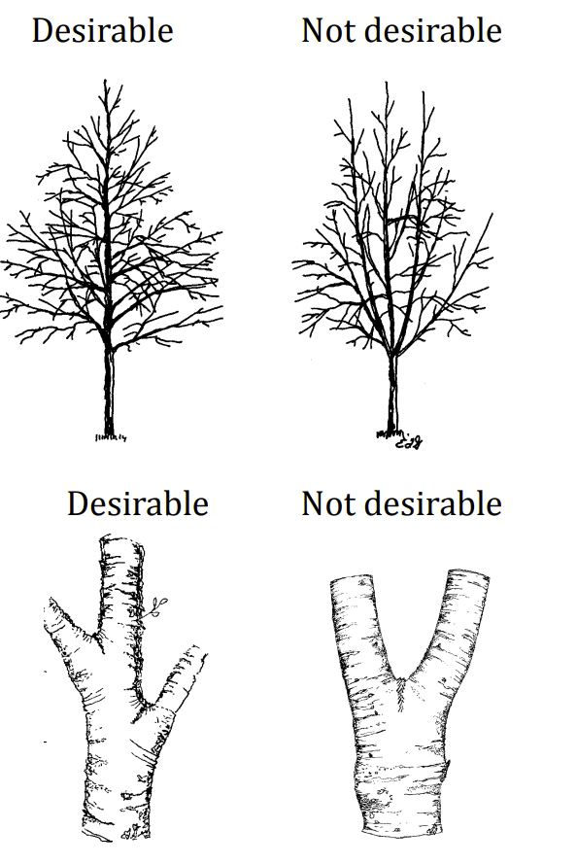
Quality nursery stock ANSI Z60.1
Straight trunk, no codominant leaders
Branches less than 2/3 of main branch,
no included bark
urbantree.org
Notes:
Buy quality plants- straightish main trunk, side branches smaller. Not good codominant leaders, week branch structure. Trunk without lower branches and no trunk taper. – tight staking is usually a bad sign. Or if tree can move in the pot and create a crater at the base of the trunk- it means tree is too deep in the pot.

Slide 10
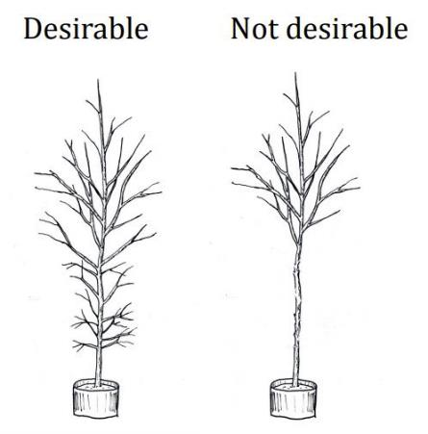
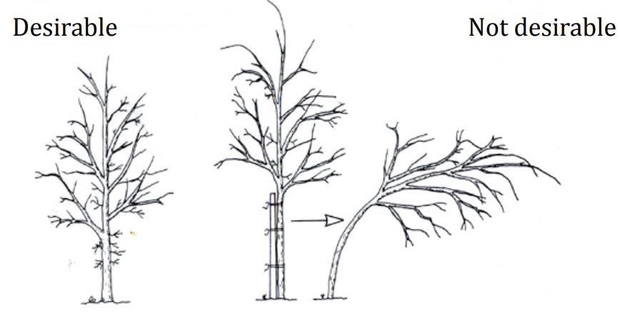
Quality nursery stock ANSI Z60.1
Lower branches present on small trees
Trunk thickness and taper to support the tree
urbantree.org

Slide 11
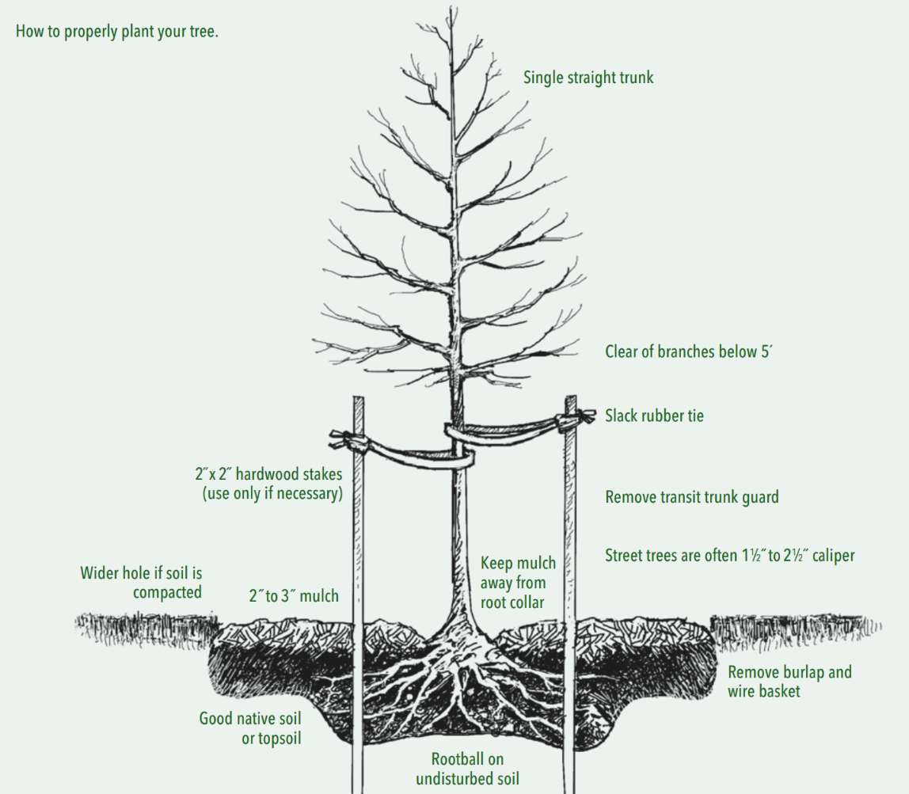
Proper Planting
Expose root flare
Hole wider but only as deep as roots
Remove burlap, wire basket; or pot and potting mix
Root flare level with ground
Spread out roots
Backfill firmly
Mulch 2-3” deep and away from trunk
Stake if needed, allow movement
Notes:
Top of topmost structural root should be visible at the surface where it separates from the trunk. Tamp soil down to prevent settling, but do not over compact. Keep ties loose around the trunk.

Slide 12
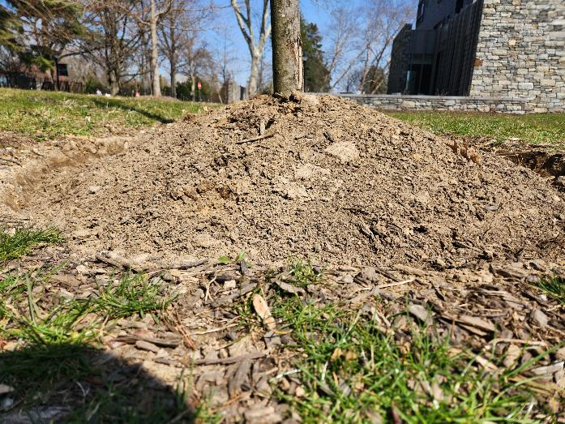
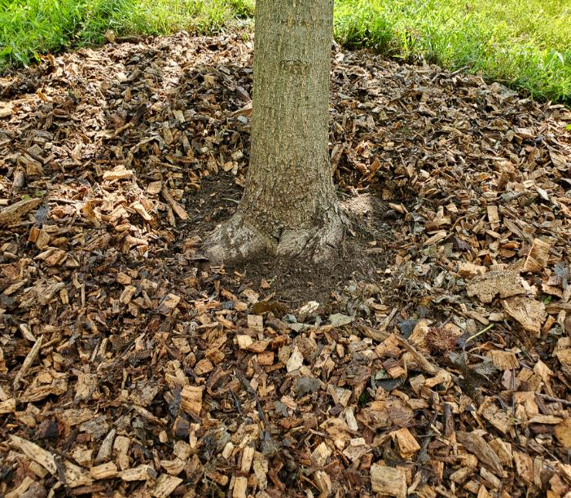
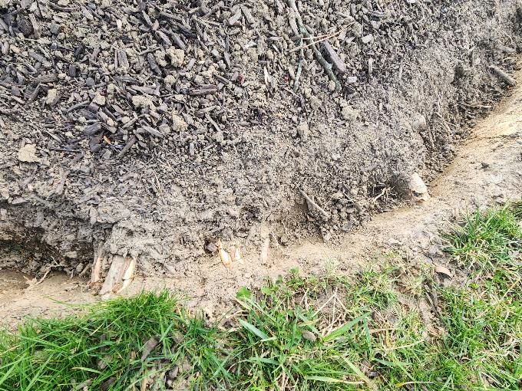
Mulching
Correct:
Away from the trunk
Low and wide
Loose, organic
Harmful:
Mulch up high
Cutting trench damages roots
Notes:
Mulch low and wide. Do not create deep trenches or cut roots around trees.

Slide 13
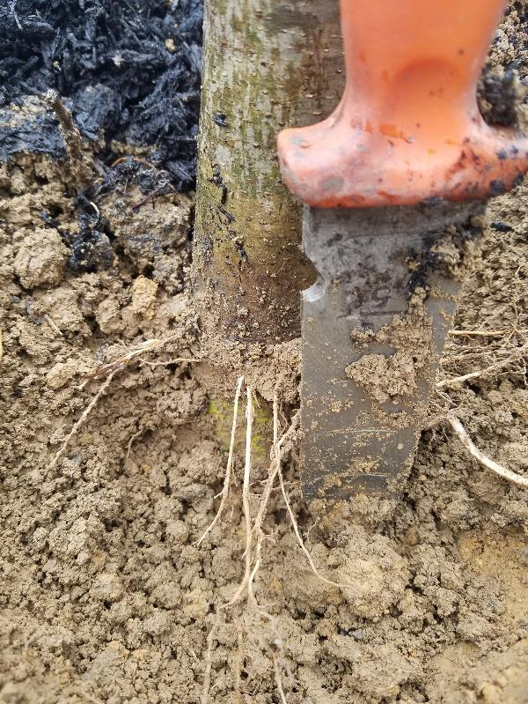
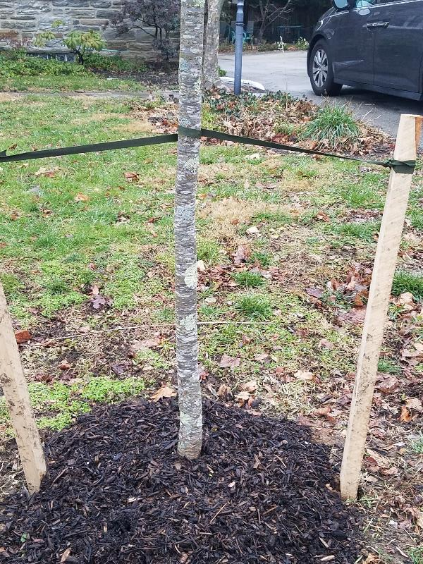
Planted, Mulched Too Deep
Notes:
Tie too tight, planted deep, adventitious root development in some species.

Slide 14
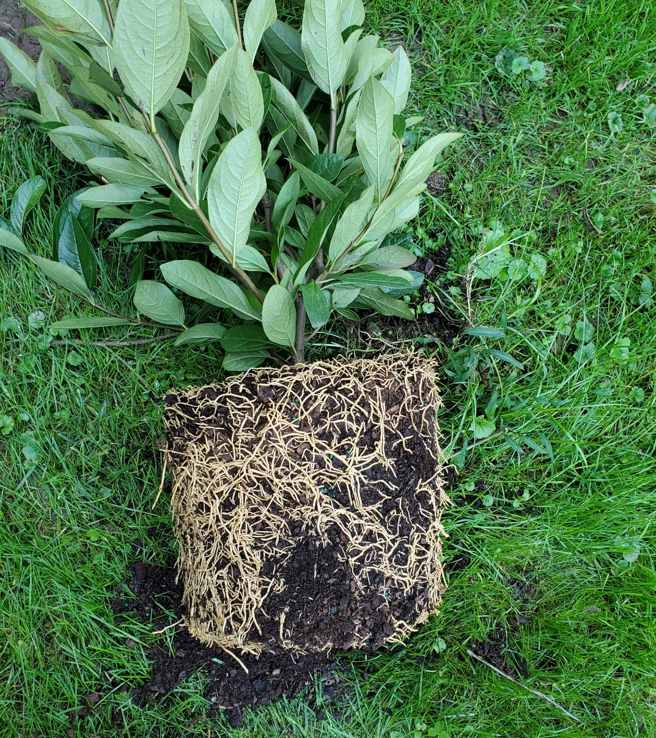
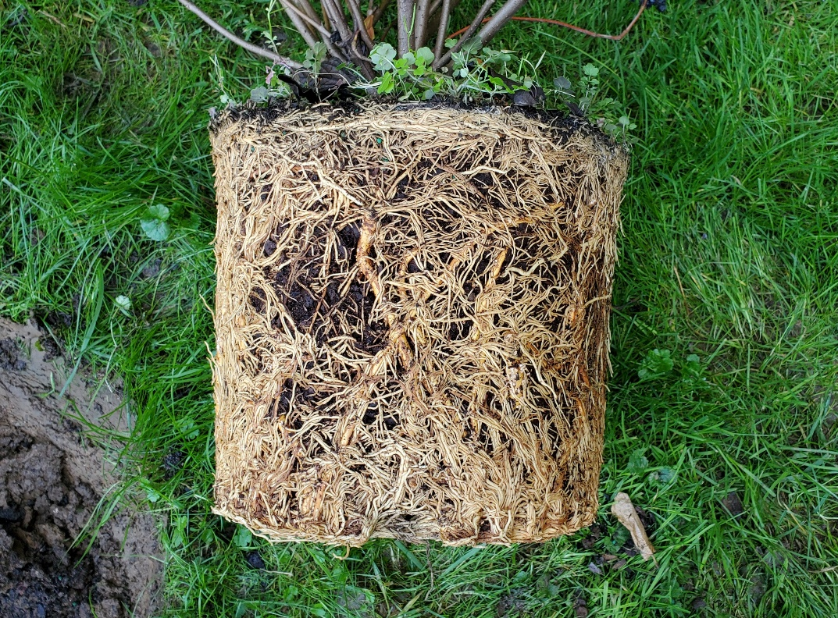
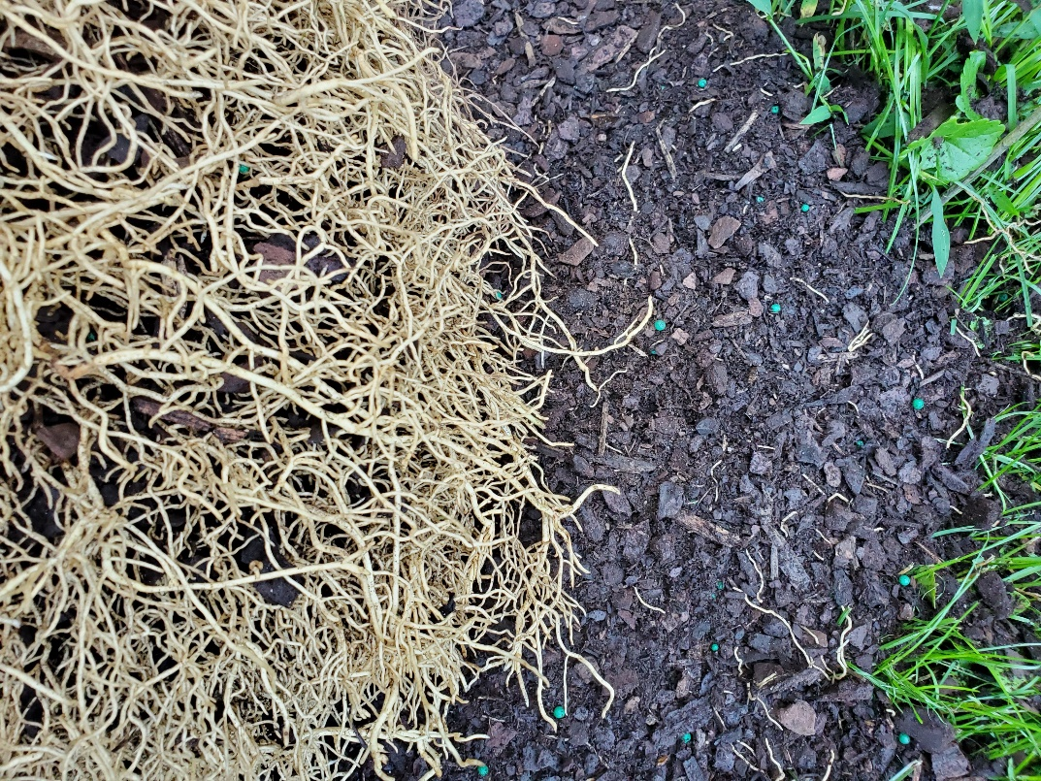
Root treatment
Root Bind
Pot-bound Roots
Notes:
Removing some or most of the potting mix, loosening roots help establishment, create root-soil contact. (potting mix gets hydrophobic when dry). Cutting kinked, circling roots helps with long term health, stability of plants.

Slide 15
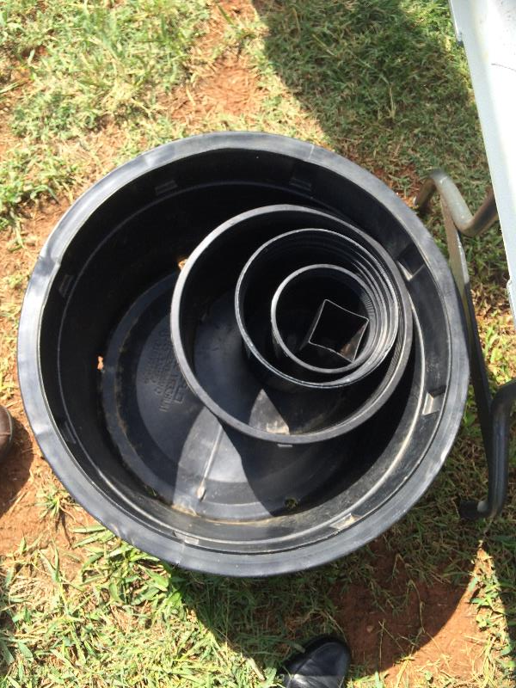
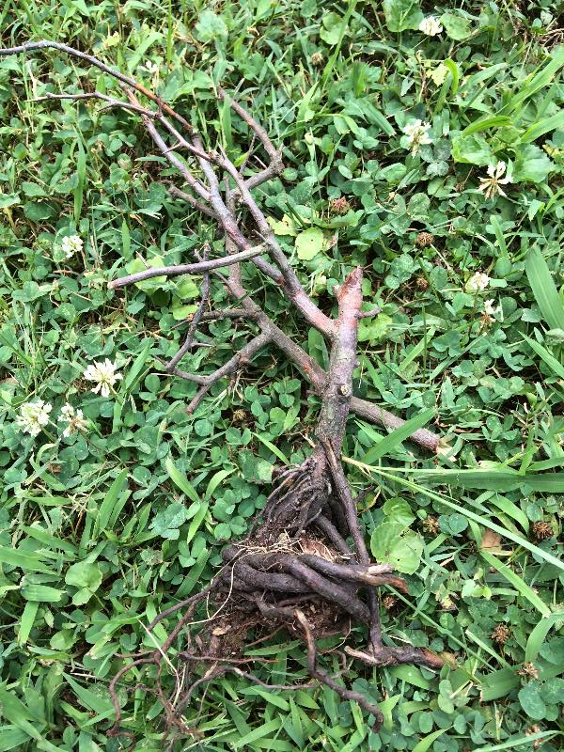
Circling, Girdling Roots
Notes:
Circling roots can develop at any stage in life and may be inside the root ball

Slide 16
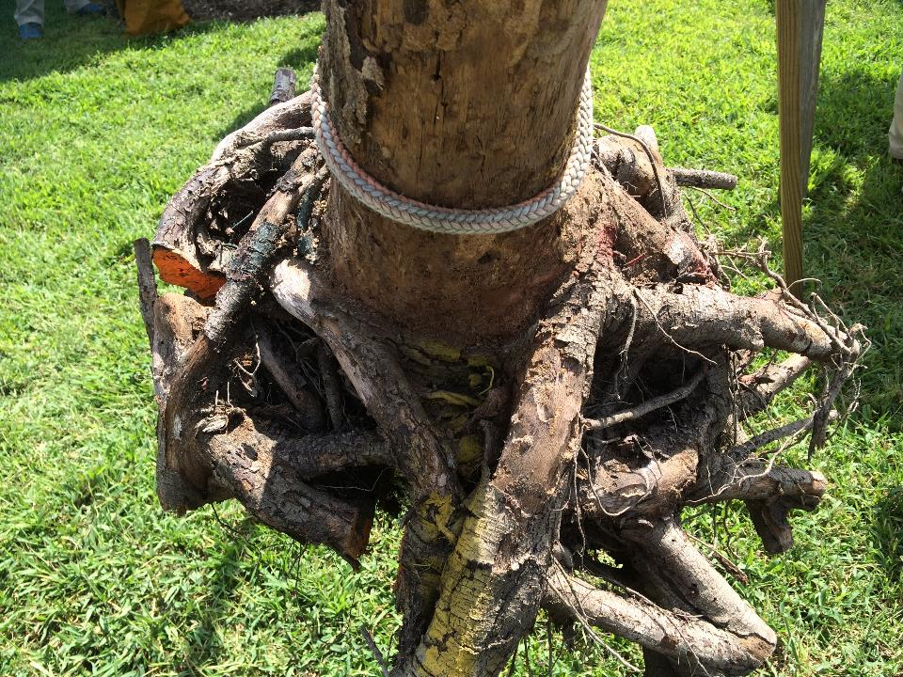
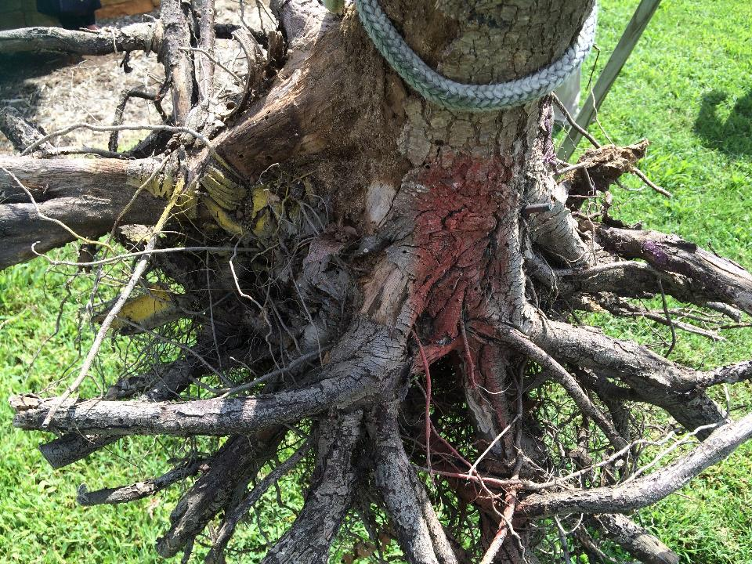
Root Treatment Before Planting
Notes:
Bartlett study of planting trees with and without turning them to bare root and repair root issues: bird nest-like root system unstable, or stable system with roots like spokes of a wheel.

Slide 17
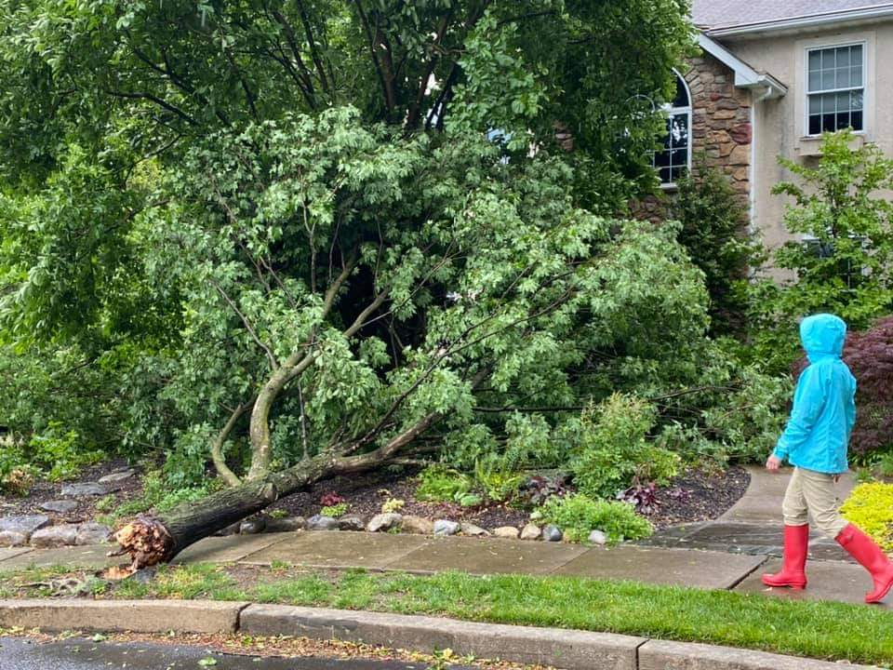
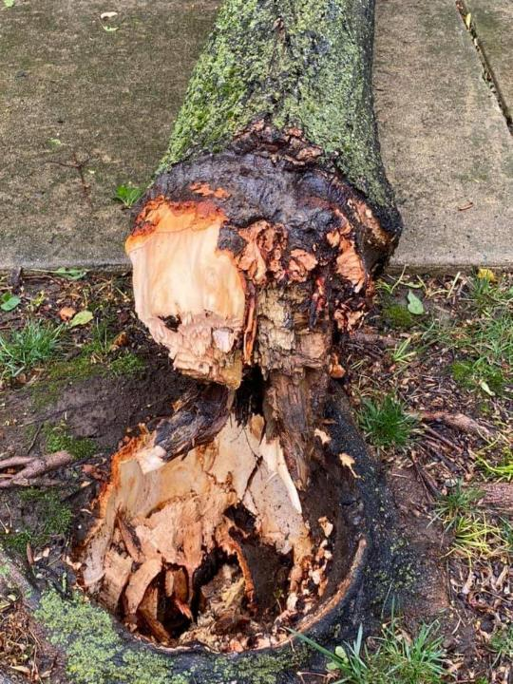
Girdling Roots Kill Trees
Notes:
Girdling root can cause die back, decay or tree failure due to pressure at the base of the tree

Slide 18
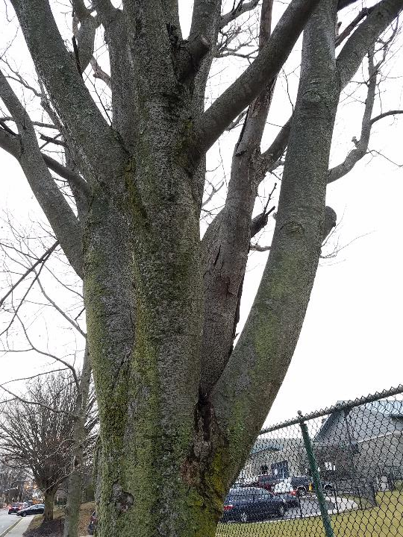
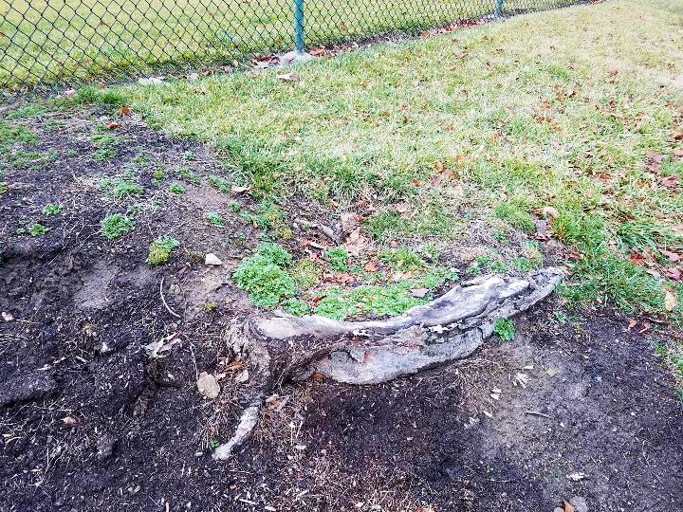
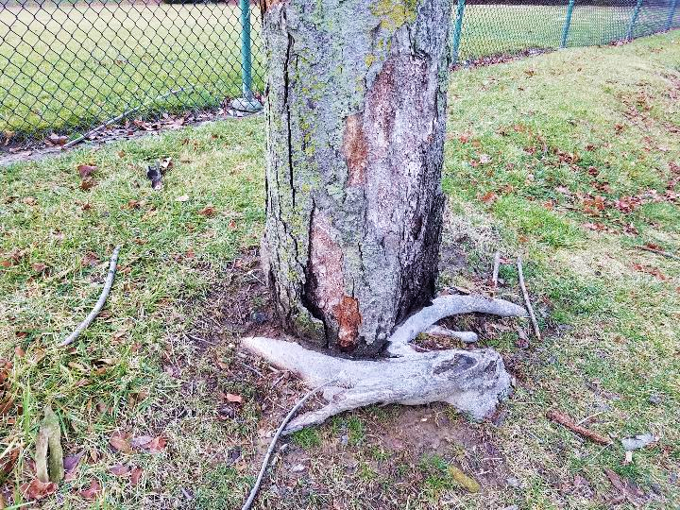
Impact of Girdling Roots
Notes:
Canopy die-back, or potential tree failure. Fix circling , girdling roots white they are small. Or hire an arborist for larger trees, more severe conditions.

Slide 19
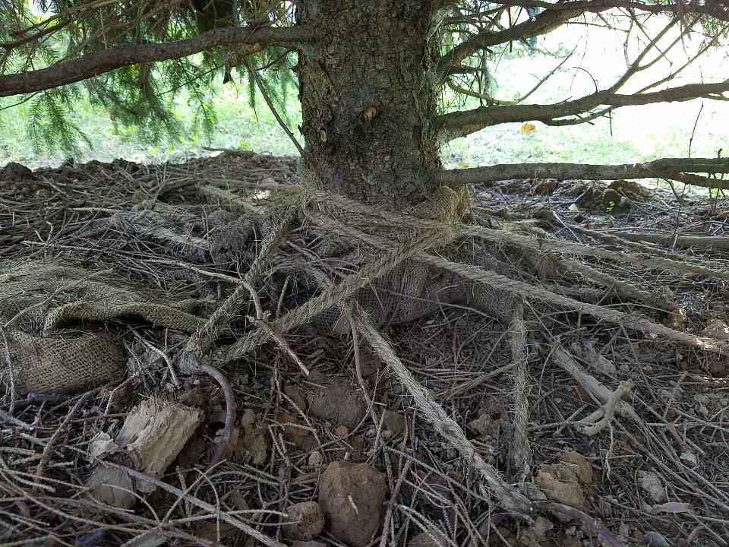
Ties, Burlap, Wire Basket
Notes:
Tied left on trees can also cause girdling

Slide 20
Pruning and Other Mechanical Damage
Pruning removes energy source
Pruning reduces root growth
Pruning is mechanical damage, creates wounds
Pruning can introduce pests and diseases
PRUNE WITH A PURPOSE
Notes:
Prune only if the benefit of pruning outweighs the negative impact

Slide 21
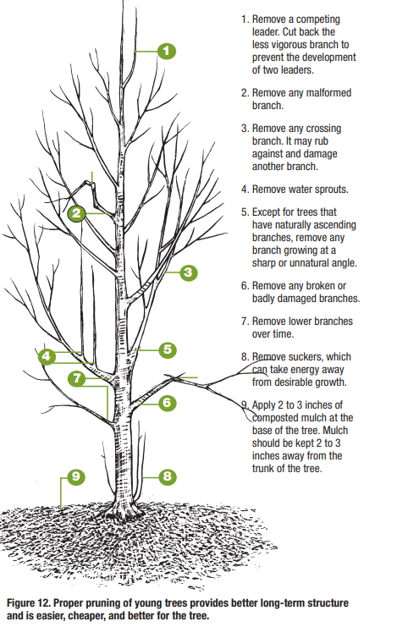
Pruning
What to cut:
The less vigorous branch of the competing leaders
Malformed branches
Crossing branches
Water sprouts
Branches growing at sharp or unnatural angle
Broken, or damaged branches
Lower branches - over time as needed
Suckers
Notes:
Focus on developing, maintaining a dominant central leader and remove or reduce branches that are more than ½ the main trunk (at attachment).

Slide 22
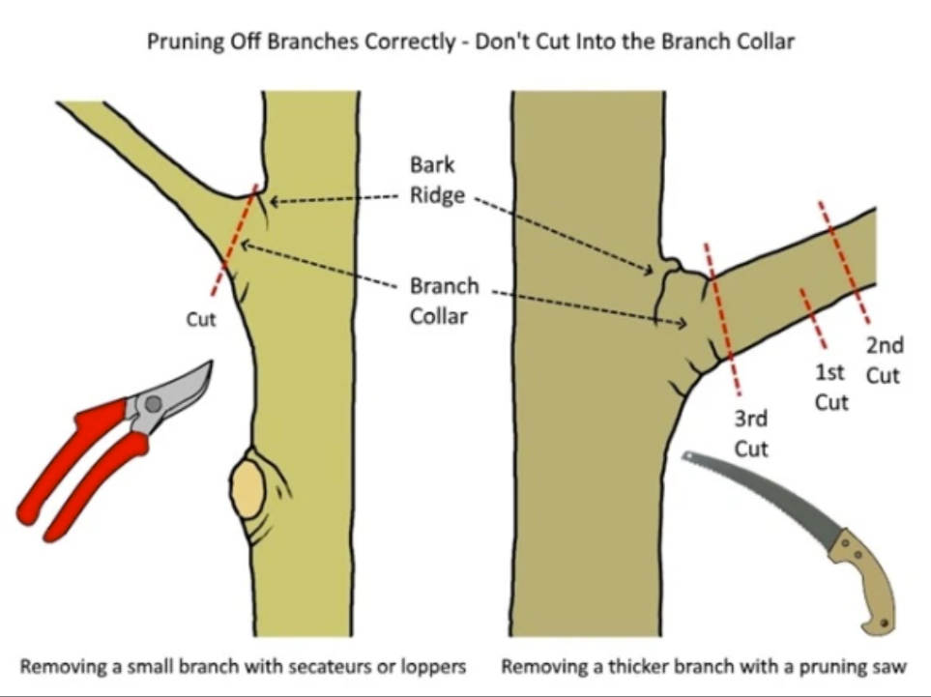
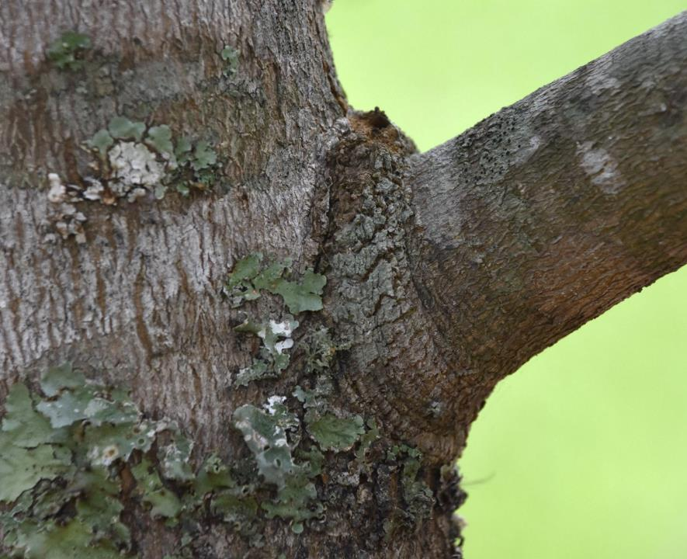
Proper Pruning Cuts
2
1
3
Notes:
Final cut just outside the branch collar, or “where it would be” if there is no visible branch collar. 3-step cut s needed for removing larger, heavier branches that cannot be held with one hand, to prevent bark ripping.

Slide 23
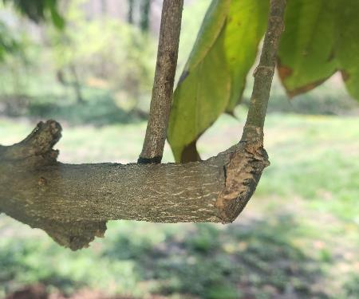
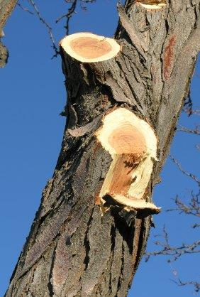
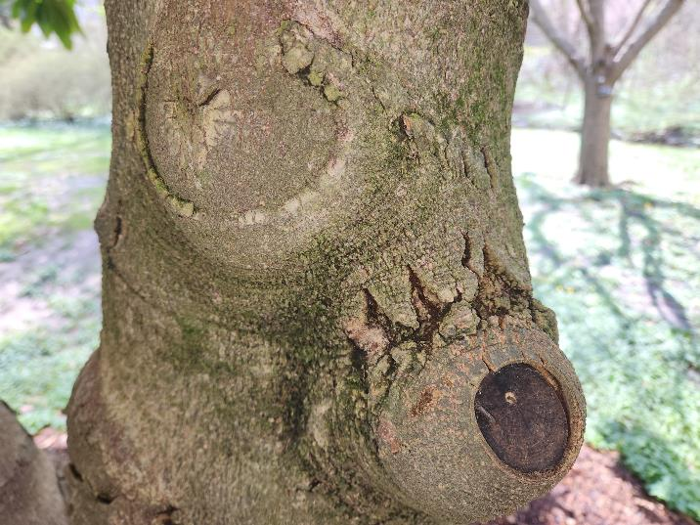
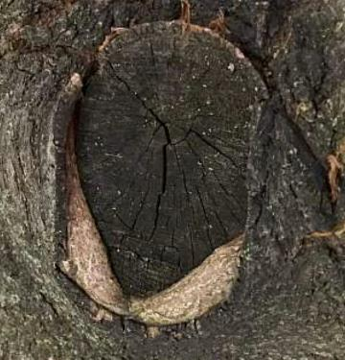
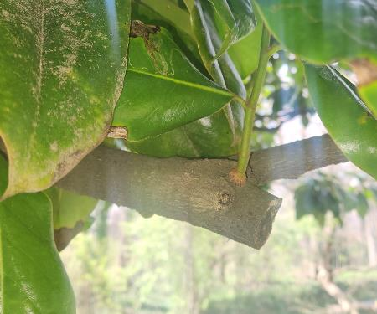
Results of pruning cuts
Incorrect:
No undercut, ripped bark
Cut inside branch collar
Cut far, leaving a stub
or too close
Correct:
Outside the branch collar
Allows fast sealing of wound
Notes:
Trees don’t heal, they seal. There will always be some dead tissue from pruning. Correct pruning mimics natural branch loss.

Slide 24
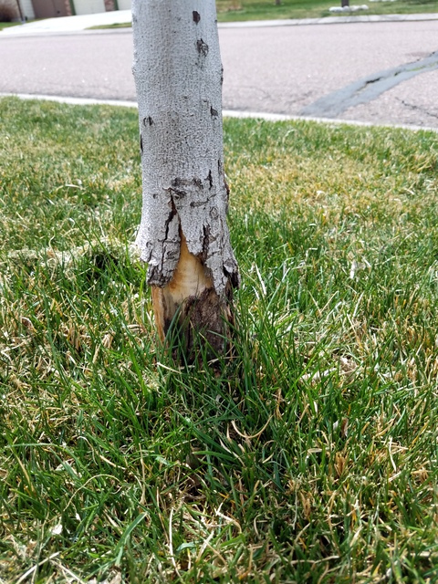
Other Mechanical Damages
String trimmer
Girdling with irrigation hose, ties etc.
Construction:
(soil, root, trunk)
Animals

Slide 25
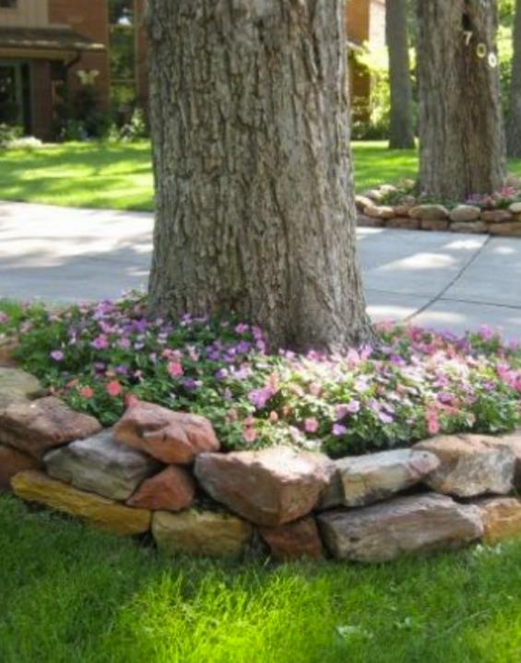
Harmful Conditions
Not enough space
Not enough air flow
Too much or too little water
Too much soil amendment
Compacted soil
Too much mulch, raised soil, etc.
Weed fabric in root zone
Road salt
Herbicides
Vines growing on trees - prevent assessing tree condition

Slide 26
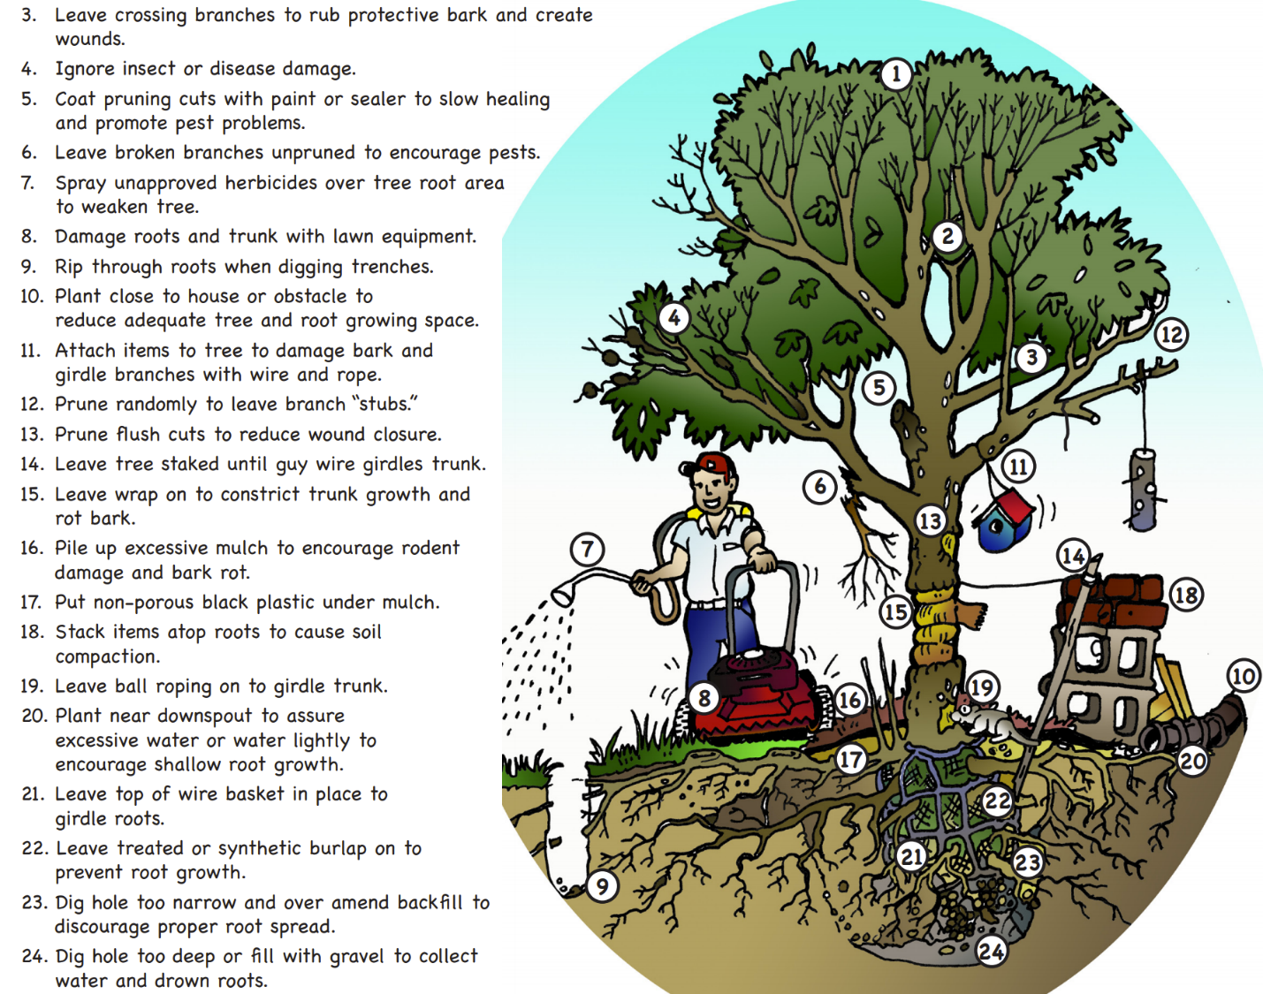
24 Ways
to Kill a Tree
Virginia Tech

Slide 27
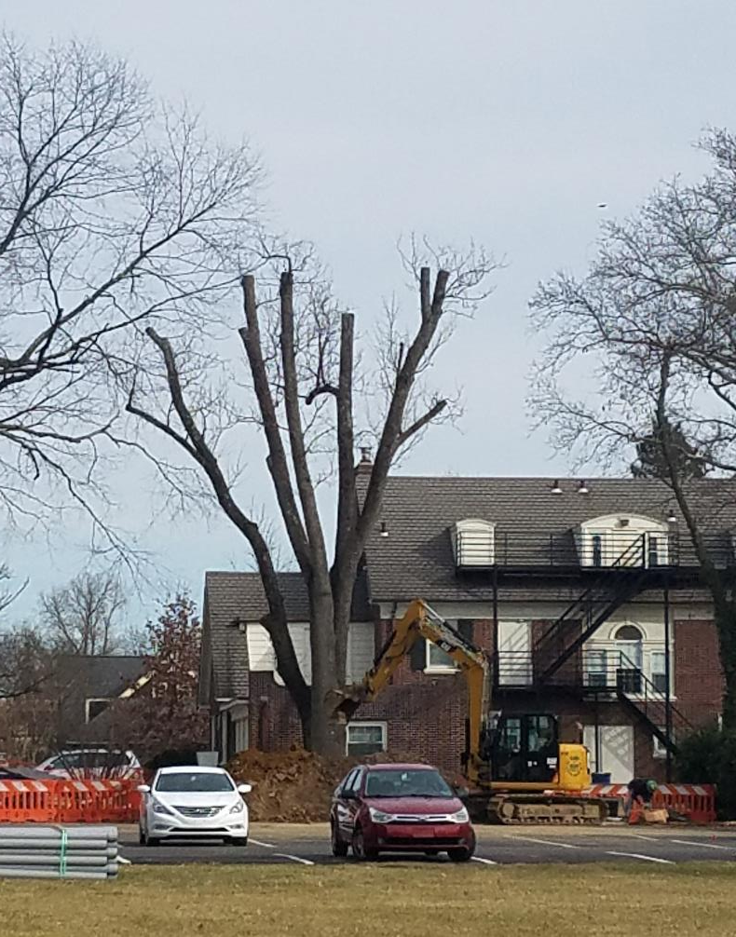
Resources
Hire reputable professionals.
Find ISA certified arborists at TreesAreGood.org
Use reliable sources for information:
DCNR
Penn State Extension
ISA
Botanical Gardens
Cornell – good species information
Virginia Tech 24 Ways to Kill a Tree
Dr Ed Gilman Pruning videos

Slide 28
DCNR Bureau of Forestry
Technical Assistance, Partners
Financial Assistance
Educational programs, presentations by Service Foresters, Urban Forestry staff
Urban and Community Forestry team - Assistance with public tree management:
Species recommendation
Code review
Policy review…
Community Conservation Partnership Program (C2P2) grants
PA Community Tree Assistance Program (Direct contracting/ITQ)

Slide 29
Invasive Replace-ive
Harrisburg- May 25th
Allentown- May 30th
Darby- May 9th
Lancaster- May 16th
Participation Criteria
Participants must:
Be a PA resident
Complete a program registration form to receive free native plants:
As part of the registration, submit photographic proof showing the removal of one or more invasive plants
Arrive in person at a giveaway location on the appropriate date and have the ability to transport native plants received.
Note: Invasive tree/shrub removal should occur by property owner(s) OR individual(s) with permission from a property owner (e.g., park, library, school, church) prior to receiving free native plants offered by the program

Slide 30
Bureau of Forestry Urban and Community Forestry
Orsolya Lazar
C-olazar@pa.gov

Slide 31
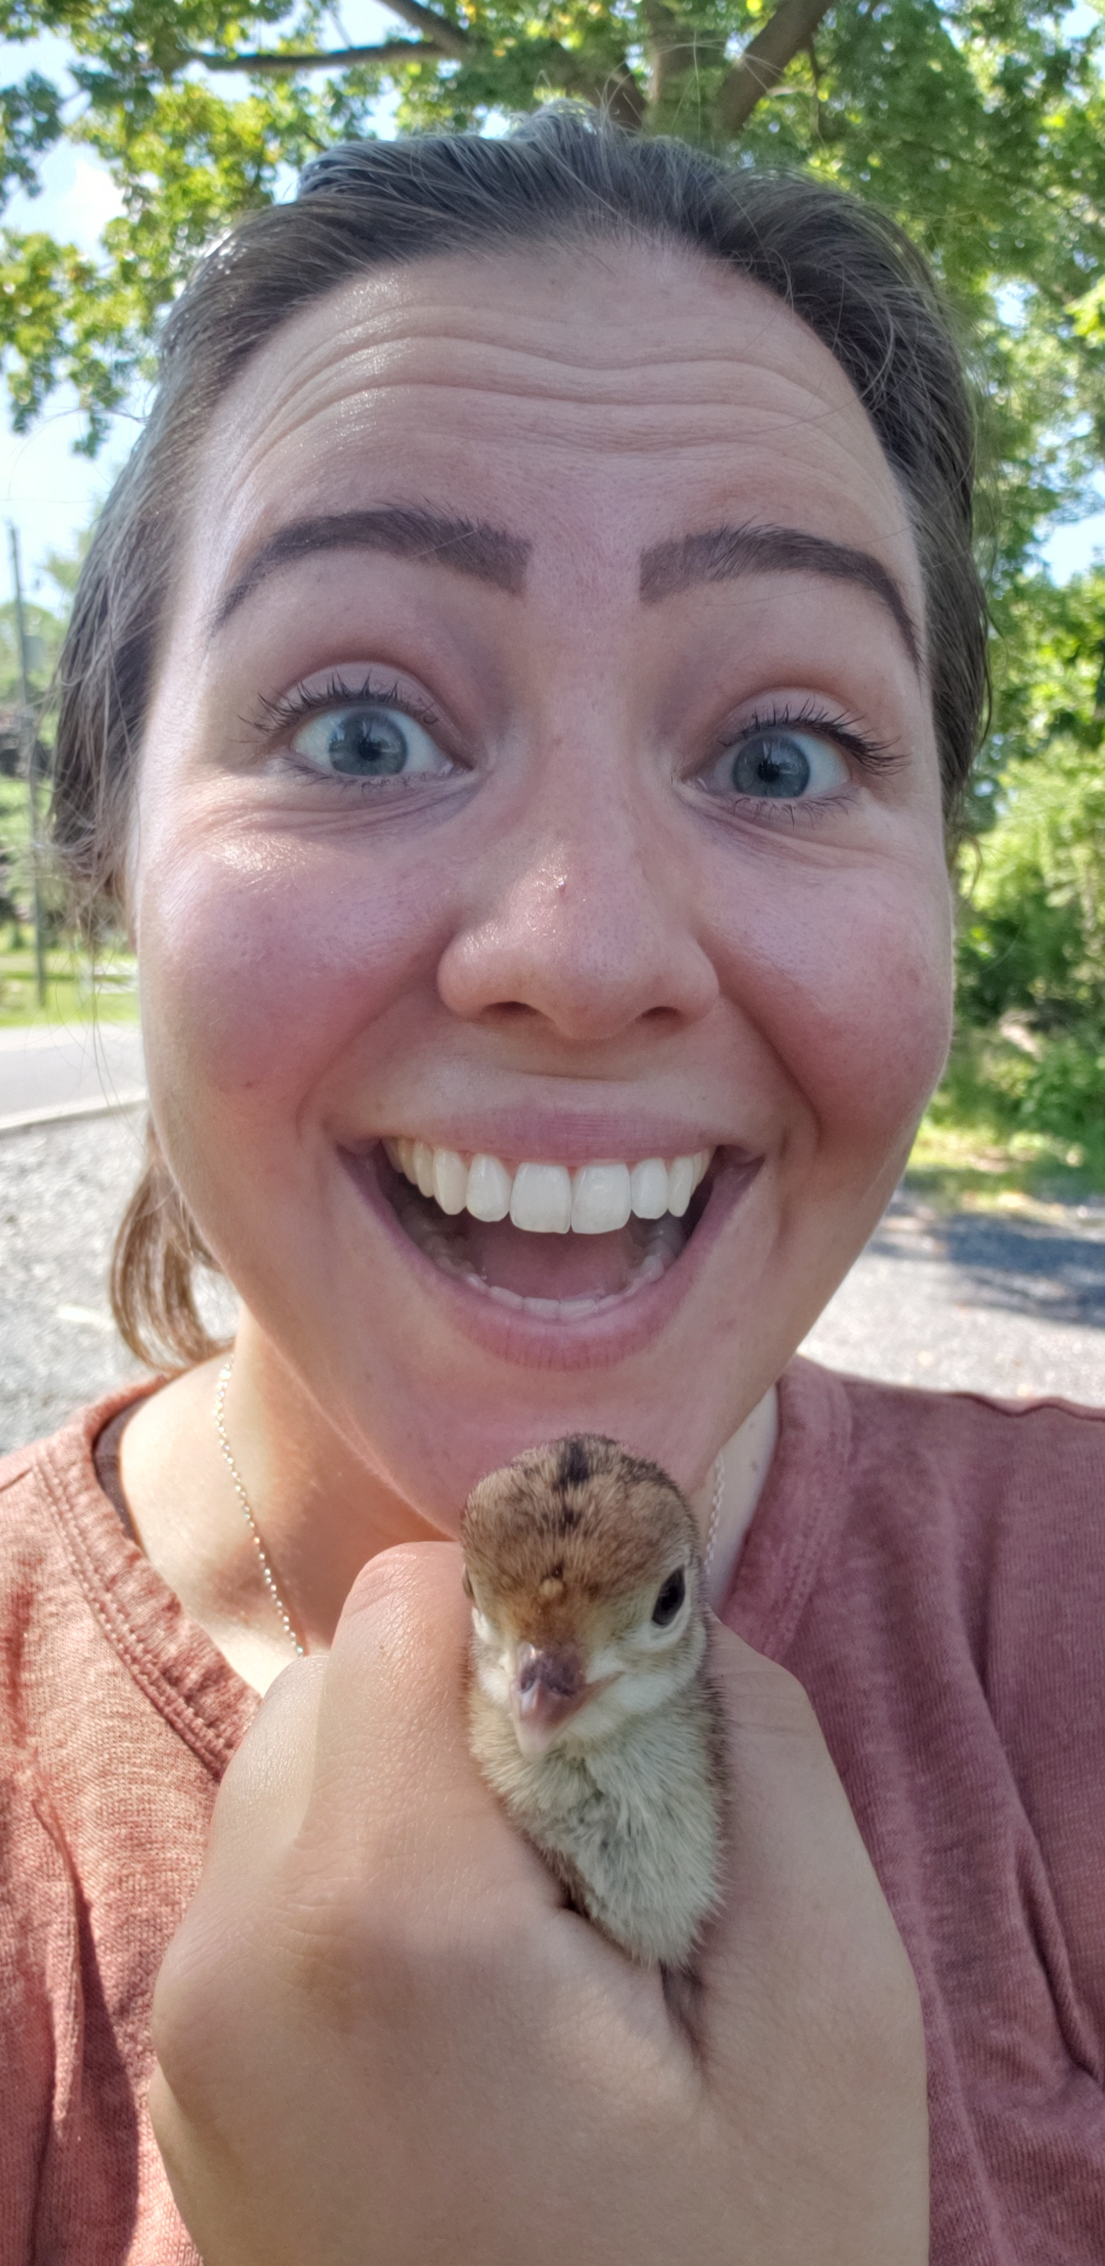
Questions?
Resources:
Bucks County Service Forester
Sara Kane
sarkane@pa.gov
(610)985-7473
Kayla Kehres | Forester
Department of Conservation & Natural Resources Bureau of Forestry | William Penn Forest District
845 Park Rd. | Elverson, PA 19520
Office:(610)582-9663 | Cell:(610)858-0038
Fax:(610)582-9692 www.dcnr.state.pa.us|www.iConservePA.org

